Slide 1



Coronary Heart Disease (CHD) Diagnosis and predict Using Traditional machine learning and MLP
Presented By:
Fikrya Ahmed Seddik Ahmed
Ahmed Mohie AbdElazeem Younis
Abdelrhman Mohamed Fawzy Ibrahim
Ibrahim Abd-elghany Ibrahim Salem
Presented to:
Dr. Mohamed Elzorkany
Internet of things (IoT) and artificial Intelligent (AI)

Slide 2
Contacts
Fikrya Ahmed Seddik Ahmed (fikryaahmed23@gmail.com 01006259628 / 01007319202)
Ahmed Mohie AbdElazeem Younis ( ahmed.younis1506@gmail.com 01551750775 )
Abdelrhman Mohamed Fawzy Ibrahim ( Abdelrhman.fawwzy@gmail.com 01554119851 )
Ibrahim Abd-elghany Ibrahim Salem ( Ibrahimsalem553@gmail.com 01091240127 )

Slide 3
Abstract
The report will describe a feasibility study to assess the use of neural networks and traditional machine learning algorithms to solve coronary heart disease (CHD) -Diagnosis and also predict a brief description of some algorithms of traditional machine learning we used.

Slide 4
Introduction
Traditional machine learning is a set of mathematical, statistical and computational methods for developing algorithms that can solve a problem not in a direct way but based on finding patterns in a variety of input data. The solution is calculated not according to a formula, but according to the established dependence of the results on a specific set of features and their values. The neural network concept is to simulate a human's neural system. Its ability to learn using previous experience and thus make fewer errors next time. This is the main feature of neural networks.

Slide 5
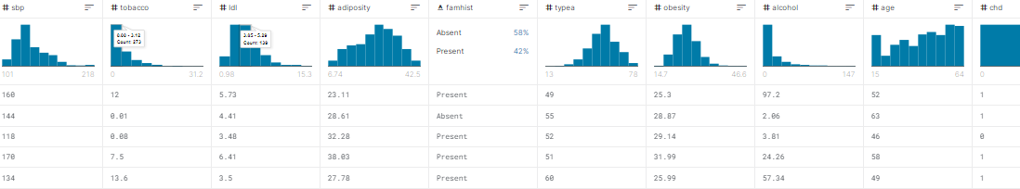
Datasets 1 (CHD Diagnostic) It contains of 9 feature and 1 output

Slide 6
Preprocessing
Check for missing values
Check for duplicate values
Encoding categorical data
Removing outliers
Scaling data

Slide 7
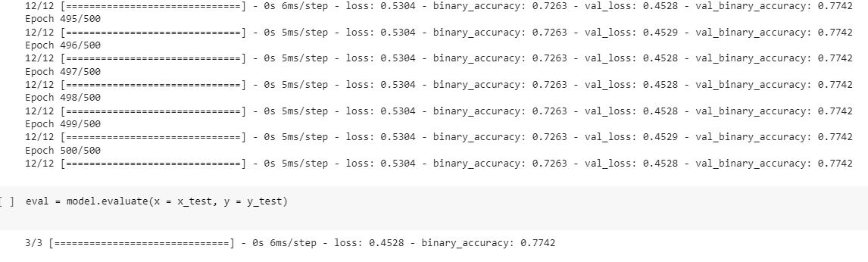
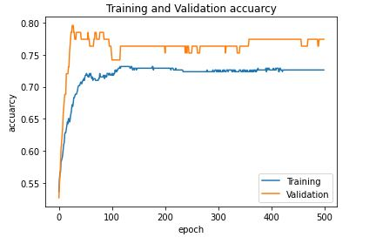
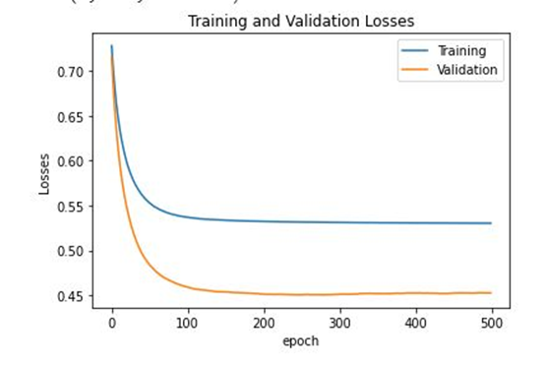
Models’ analysis using Neural Network “First Result”

Slide 8
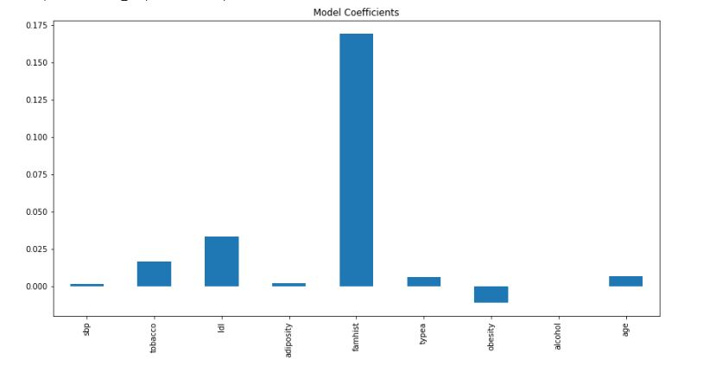
By using lasso-regression to do automatic feature selection

Slide 9
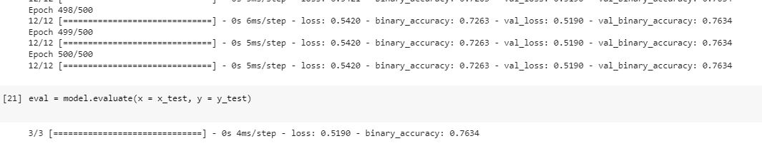
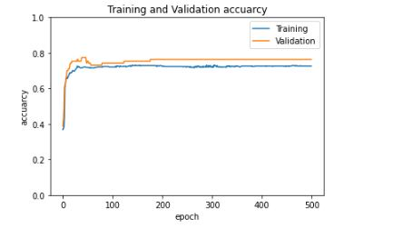
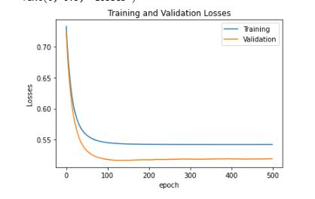
By dropping 6 low features: (binary_accuracy: 0.7634)

Slide 10
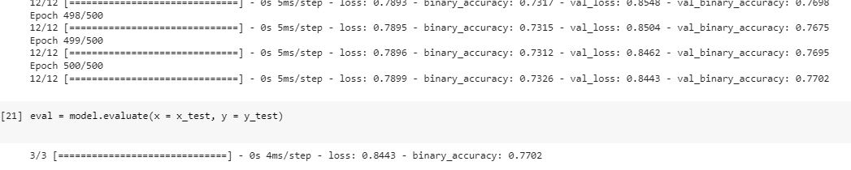
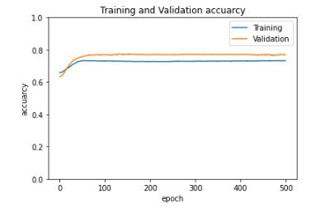
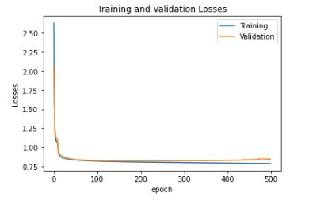
By adding hidden layers (binary_accuracy: 0.7702)

Slide 11
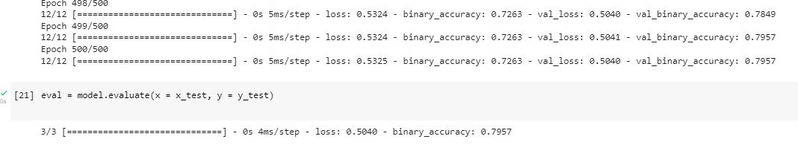
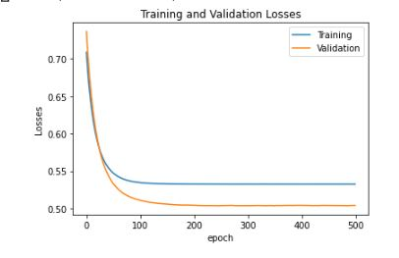
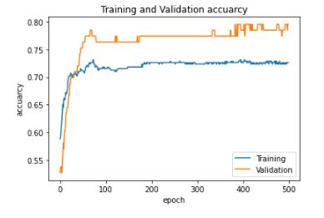
By dropping 5 low features: (binary_accuracy: 0.7957)

Slide 12
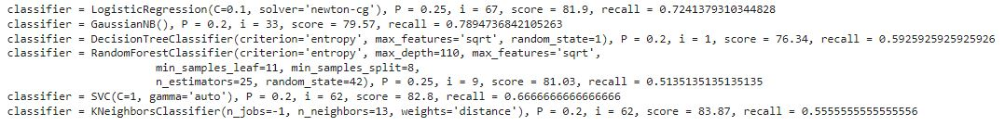
Using the traditional ML

Slide 13
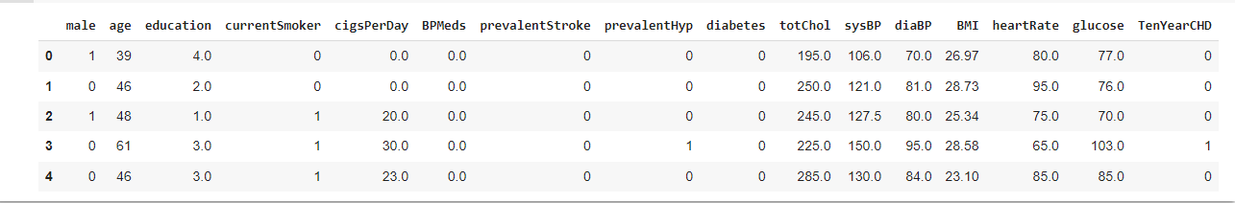
Datasets 2 “CHD Prediction” Its content 15 Features and 1 output

Slide 14
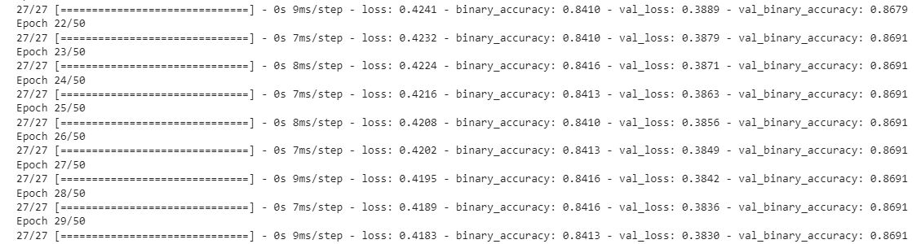
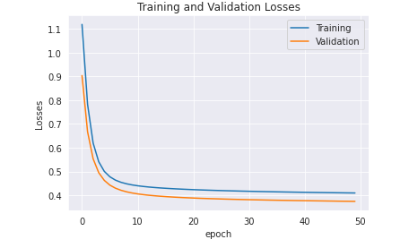
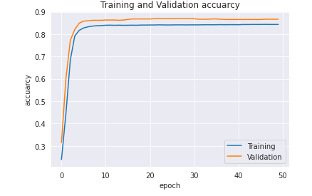
Models’ analysis using Neural Network

Slide 15
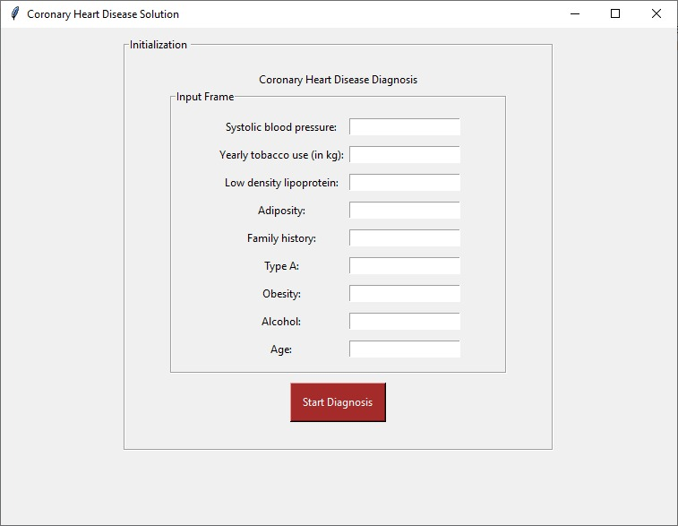
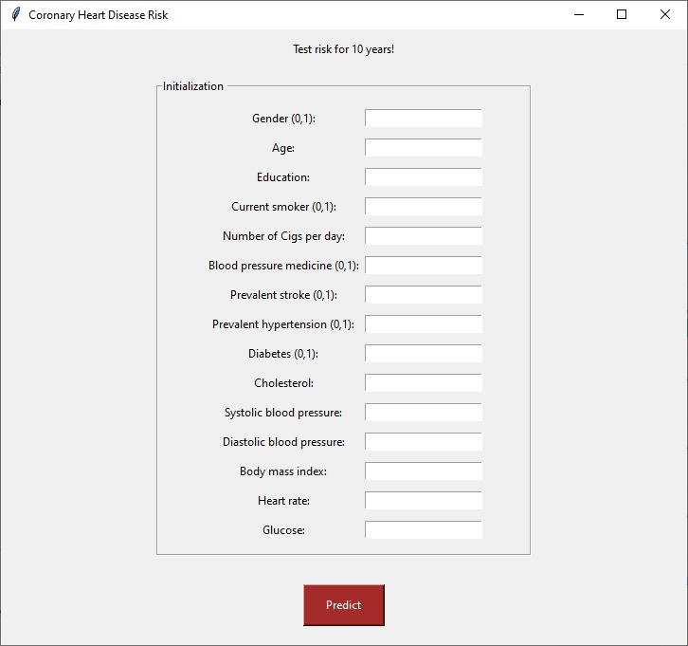
GUI

Slide 16
Conclusion
In this project we used two datasets for CHD to diagnosis and prediction for 10 years. First the previous projects maximum accuracy was 69%using traditional Machine Learning models. we managed to increase it using (SVM) traditional Machine Learning to 82.8, and by applying neural network to the model the accuracy did not exceed 79% that mean that the dataset is not complicated enough to apply MLP.
The second dataset we used to get higher percentage, by using traditional Machine Learning models the (SVM) got high score of 87.45% and by applying neural network to the model the accuracy did not exceed 86.6

Slide 17
References
https://www.kaggle.com/code/camillevleonard/bayesian-model-averaging-logistic-regression
https://www.kaggle.com/code/bmfeciura/bayesian-model-averaging-logistic-regression
https://www.ncbi.nlm.nih.gov/pmc/articles/PMC3477961/
https://www.kaggle.com/code/yassinehamdaoui1/heart-attack-ensembles-dimensionality-reduction/notebook
https://scikit-learn.org/stable/modules/generated/sklearn.metrics.recall_score.html
https://keras.io/api/optimizers/

